Slide 1
​Racial Demographics and U.S. GDP: 2017-2022
Led by Ole Forsberg and Andrew Leahy
Funded by Richter Memorial Fund

Slide 2
The purpose of this presentation is to show difference GDP per capita change 2017-2022 in rural and urban areas and how it has been affected by Indian Subcontinent, Hispanic and African American populations.

Slide 3
A county with a population over 50,000 is classified as metropolitan. Counties with populations between 10,000 and 50,000 are considered micropolitan, while those with fewer than 10,000 residents are deemed rural.
Classification Method

Slide 4
In the following slides, we excluded data that was missing and removed county data for which the population of the Indian subcontinent, African American, and Hispanic was interfering with the graph's clarity.

Slide 5
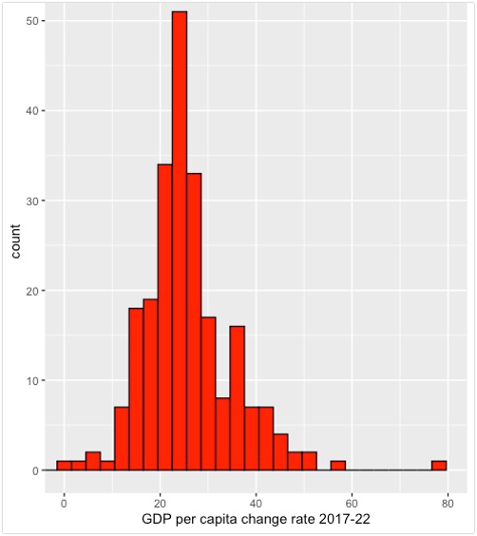
​
The histogram shows the distribution of GDP per capita change from 2017 to 2020 . The histogram shows the patterns of normal distribution and most of the data is centered around the mean,33.60101%
Top five counties with the most GDP per capita change rate
NAME Area GDP per capita change rate 2017-22
1 Stewart County, Georgia Metropolitan Statistical Area 77.3
2 Whatcom County, Washington Metropolitan Statistical Area 57.9
3 Solano County, California Metropolitan Statistical Area 50.3
4 Jefferson County, Iowa Rural 49.7
5 Mercer County, New Jersey Metropolitan Statistical Area 48.8

Slide 6
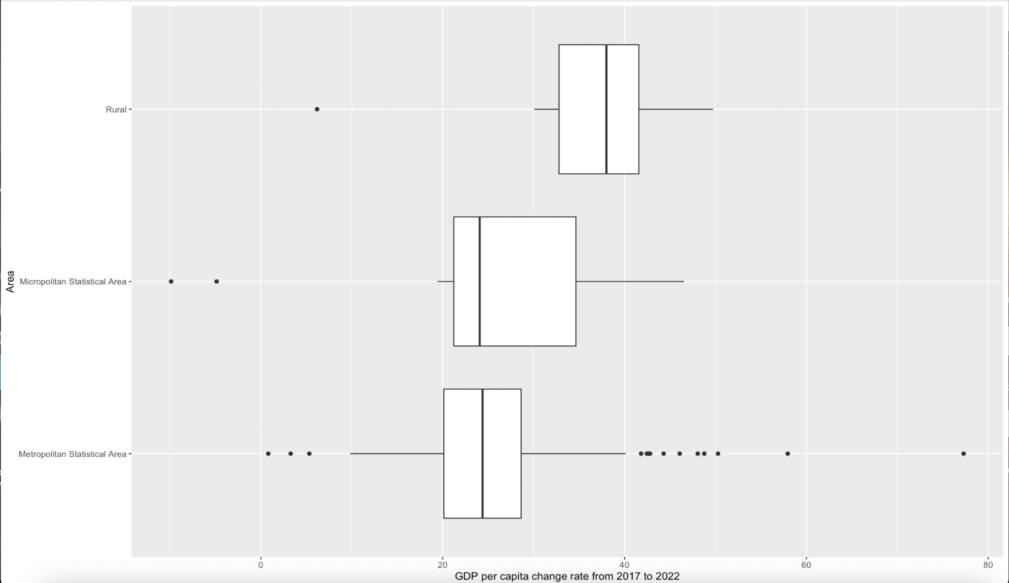
Boxplot of GDP per capita change from 2017 to 2022
Area Average GDP per capita
1 Metropolitan Statistical Area 25.3
2 Micropolitan Statistical Area 24.4
3 Rural 34.7

Slide 7
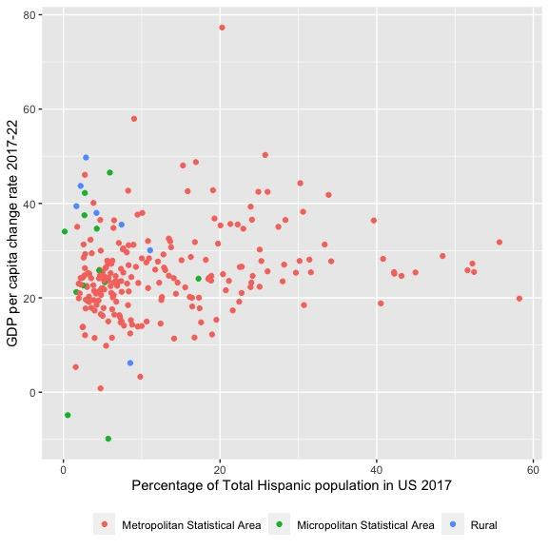
Hispanics
Stewart County, Georgia
The Y axis represents GDP per capita change rate 2017-2022, the X-axis represents percentage population of Total Hispanic population in US 2017 and the color represents the classification of the area. We can see an increasing trend as we move along the X-axis.
Bronx County, New York
Merced County, California
Washington County, Oklahoma

Slide 8
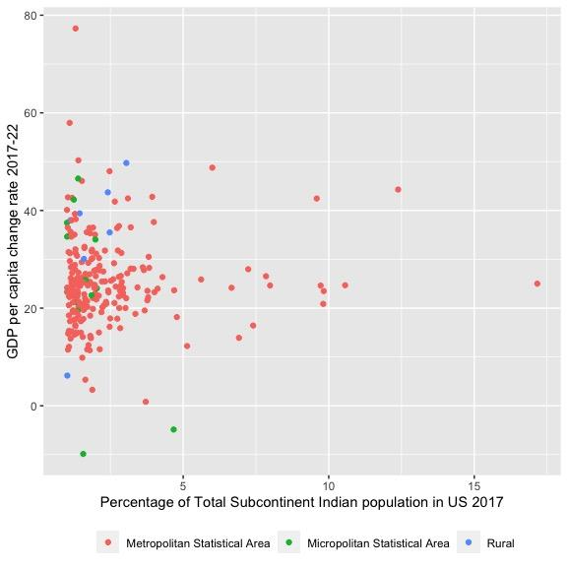
Indian-Subcontinent
Stewart County, Georgia
Sutter County, California
The Y axis represents GDP per capita change rate 2017-2022, the X-axis represents percentage population of Total Subcontinent Indians in US 2017 and the color represents the classification of the area. There is not a visible trend in the graph.
Middlesex County, New Jersey
Washington County, Oklahoma

Slide 9
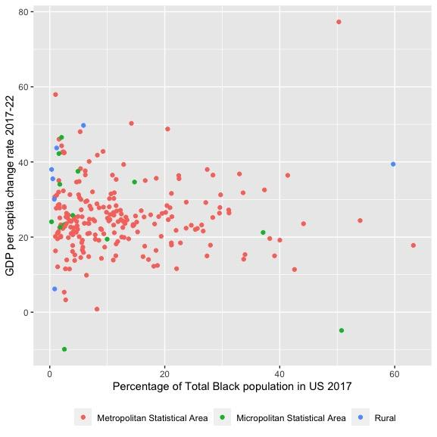
African American
Stewart County, Georgia
WhatCom County, Washington
The Y axis represents GDP per capita change rate 2017-2022, the X-axis represents percentage population of Total Black population in US 2017 and the color represents the classification of the area. There is not a visible trend in the graph.
Randolph County, Georgia
DeKalb County, Georgia
Prince George’s County, Maryland
Quitman County, Georgia
Washington County, Oklahoma

Slide 10
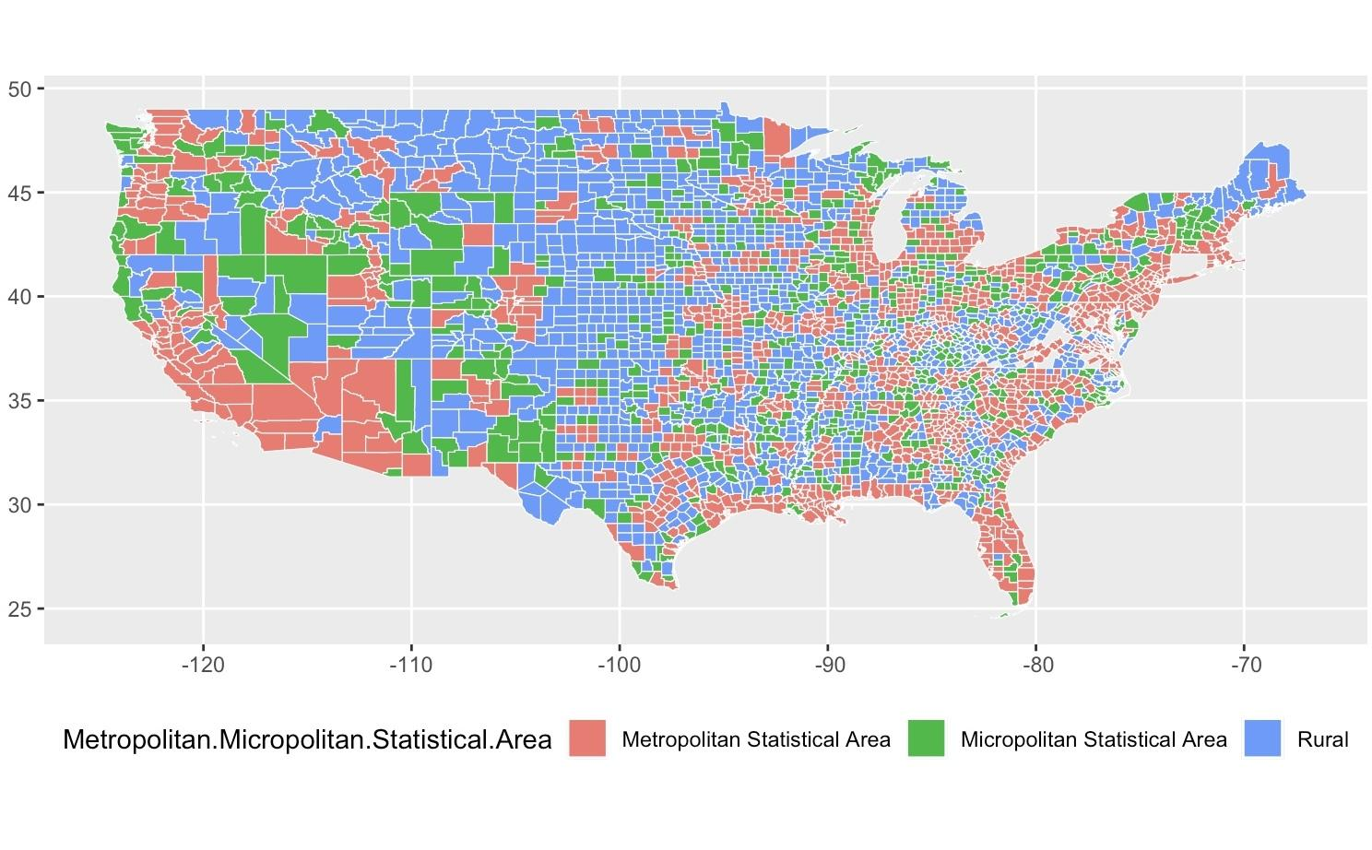

Slide 11
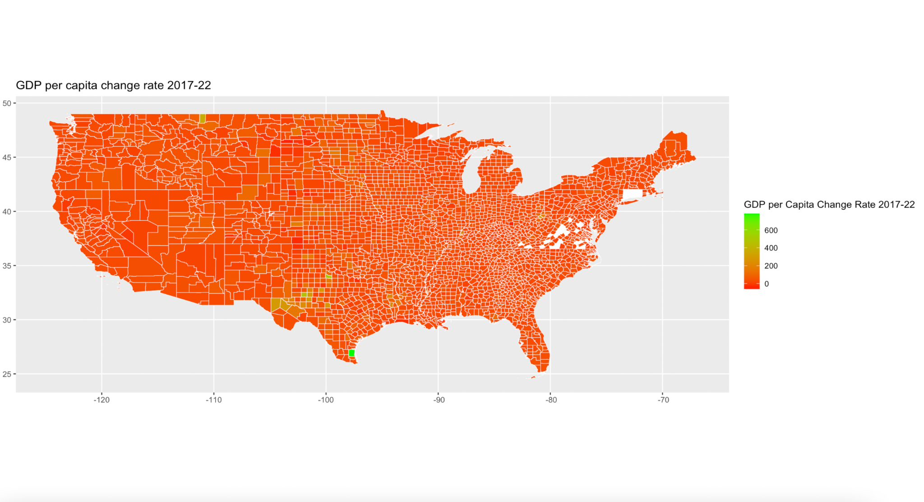

Slide 12
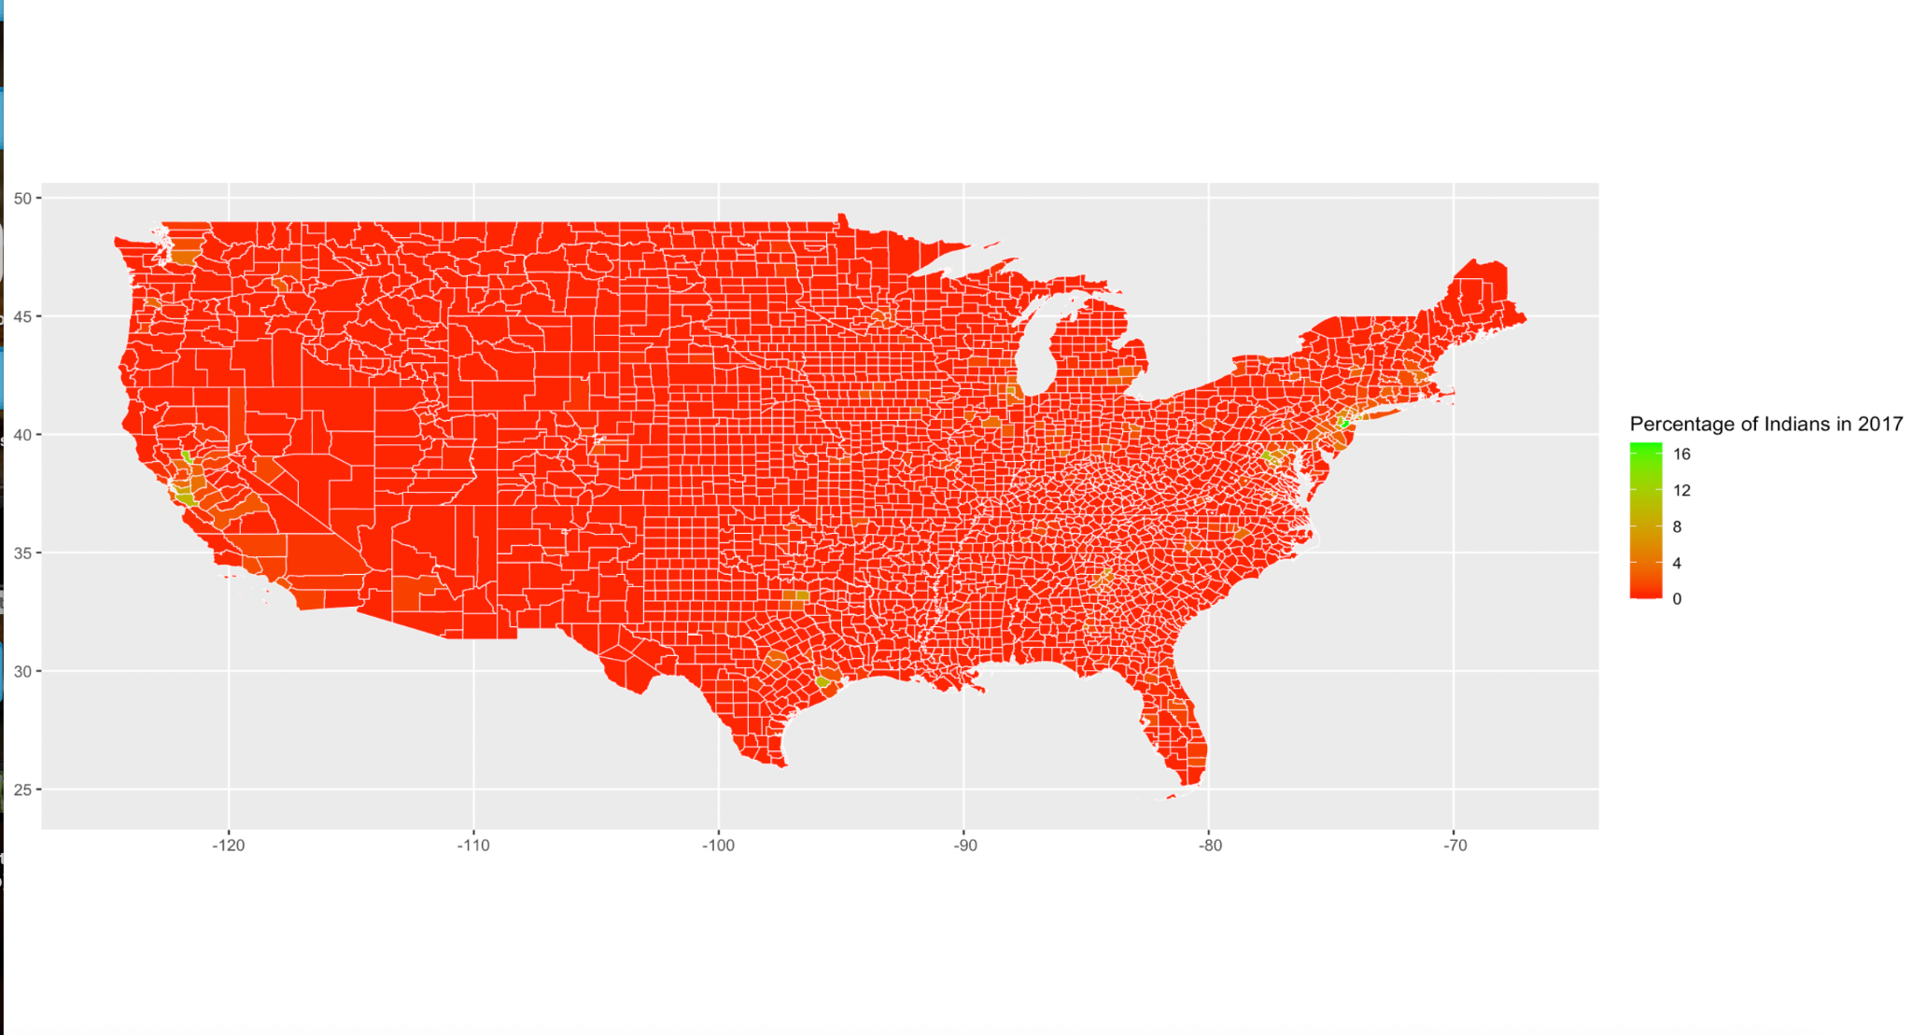
Percentage of Subcontinent Indians in US 2017 Map

Slide 13
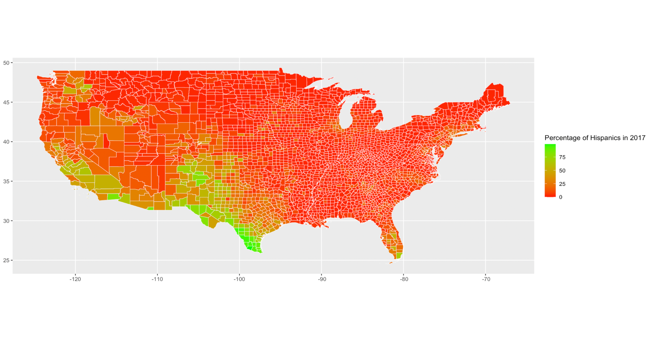
Percentage of Hispanic in US 2017 Map

Slide 14
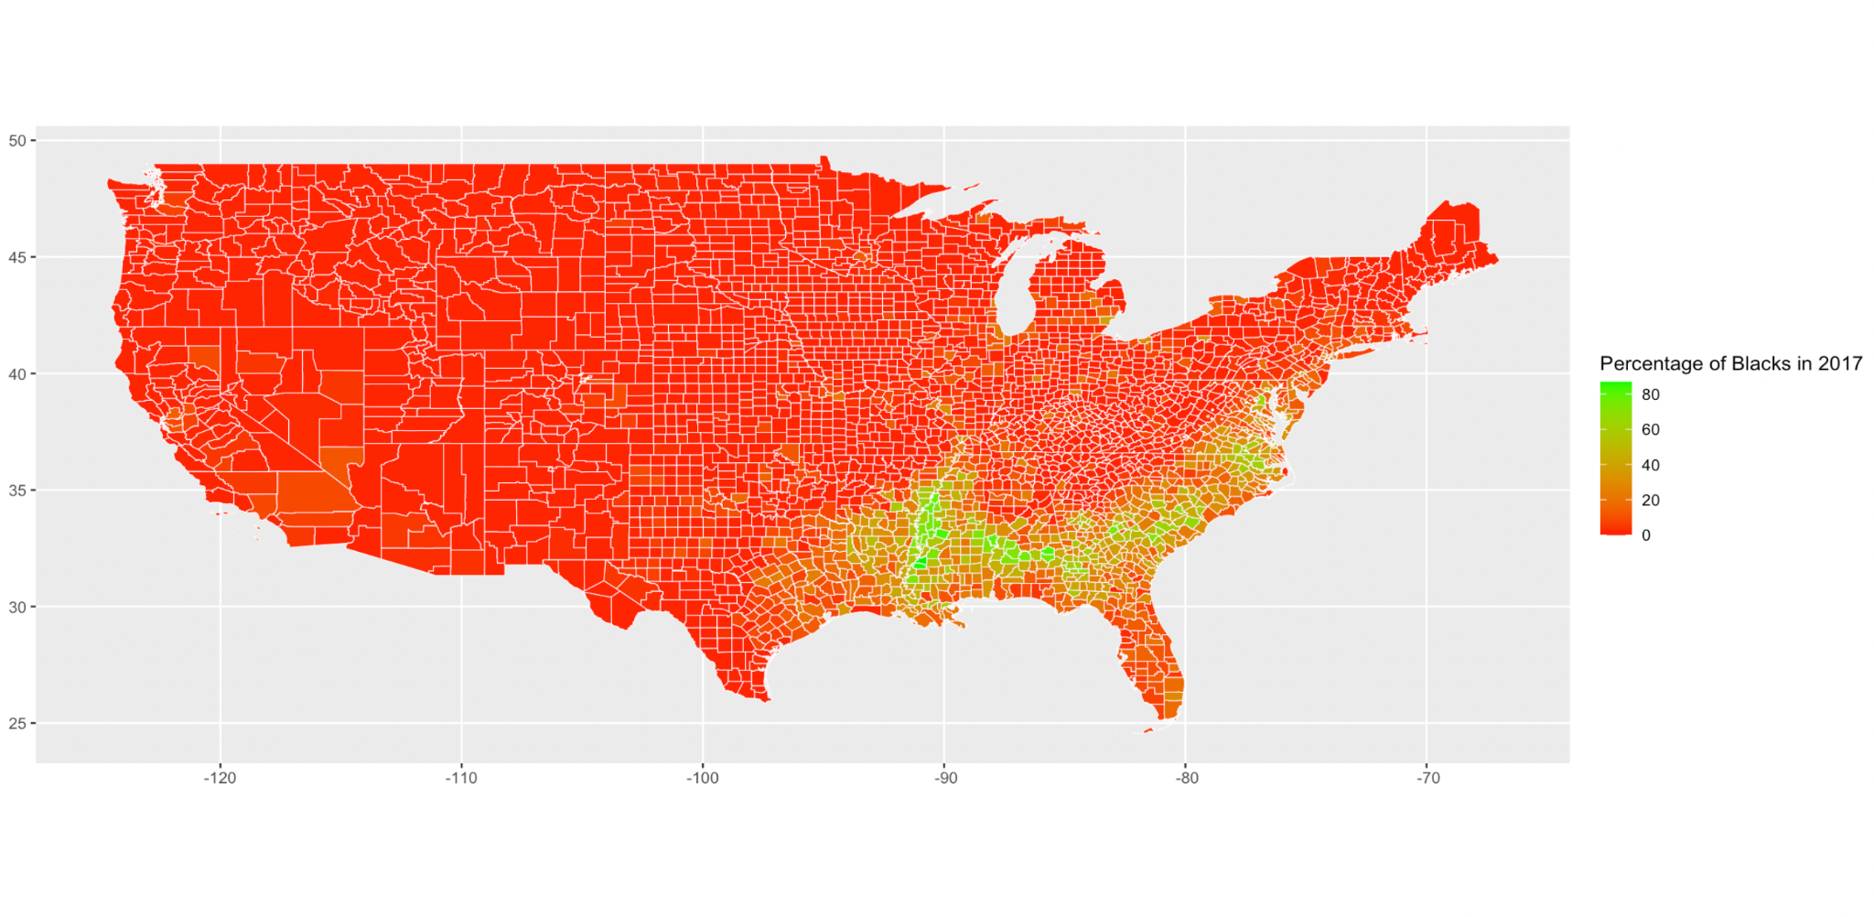
Percentage of African American in US 2017 Map

Slide 15
Linear Models

Slide 16
Linear model of GDP per capita change rate 2017-2022 as function of percentage population of Total Subcontinent Indians in US 2017 and classification area
lm(formula = finaldata2$GDPpercapchangerate17_22 ~ finaldata2$percentotalsubind17 *
finaldata2$Metropolitan.Micropolitan.Statistical.Area)
Coefficients:
Estimate
(Intercept) 24.7526
Percentage of Indian population and Micropolitan Area combined effect -9.9883
Percentage of Indian population and Rural Area combined effect 12.0958
Pr(>|t|)
(Intercept) < 2e-16
Percentage of Indian population and Micropolitan Area combined effect 0.00061
Percentage of Indian population and Rural Area combined effect 0.01684
Multiple R-squared: 0.09899, Adjusted R-squared: 0.07924

Slide 17
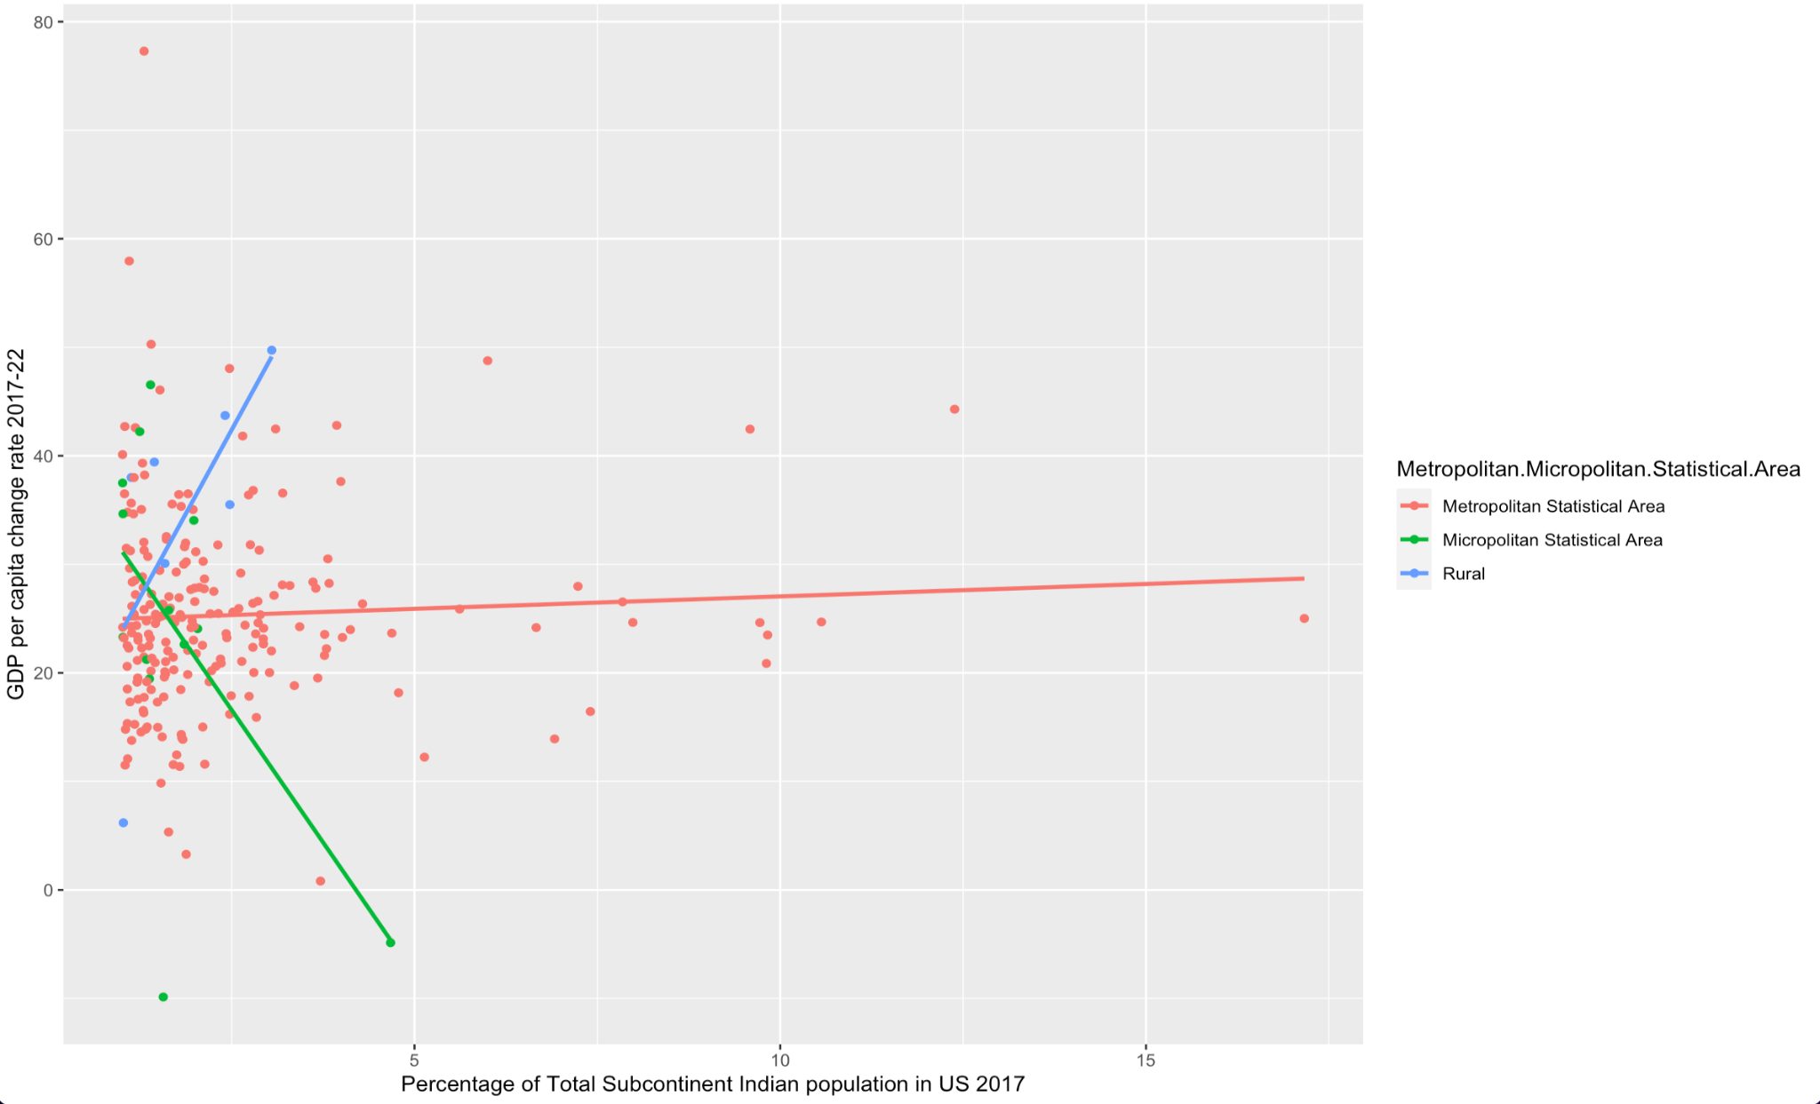

Slide 18
The graph shows there is noticeable difference in the slope of Metropolitan Statiscal Area and Micropolitan Area as well as the slope of Metropolitan Area and Rural Area for the percentage of indian population in 2017 and GDP per capita change from 2017 to 2022 is consistent with the linear model summary.

Slide 19
Linear model of GDP per capita change rate 2017-2022 as function of percentage population of Total Hispanic in US 2017 and classification area
lm(formula = finaldata2$GDPpercapchangerate17_22 ~ finaldata2$percentotalhisp17 *
finaldata2$Metropolitan.Micropolitan.Statistical.Area)
Coefficients:
Estimate
(Intercept) 22.80864
Percentage of Hispanic population and Micropolitan Area combined effect -0.08920
Percentage of Hispanic population and Rural Area combined effect -2.77426
Pr(>|t|)
(Intercept) < 2e-16
Percentage of Hispanic population and Micropolitan Area combined effect 0.889711
Percentage of Hispanic population and Rural Area combined effect 0.010792
Multiple R-squared: 0.09333, Adjusted R-squared: 0.07345

Slide 20
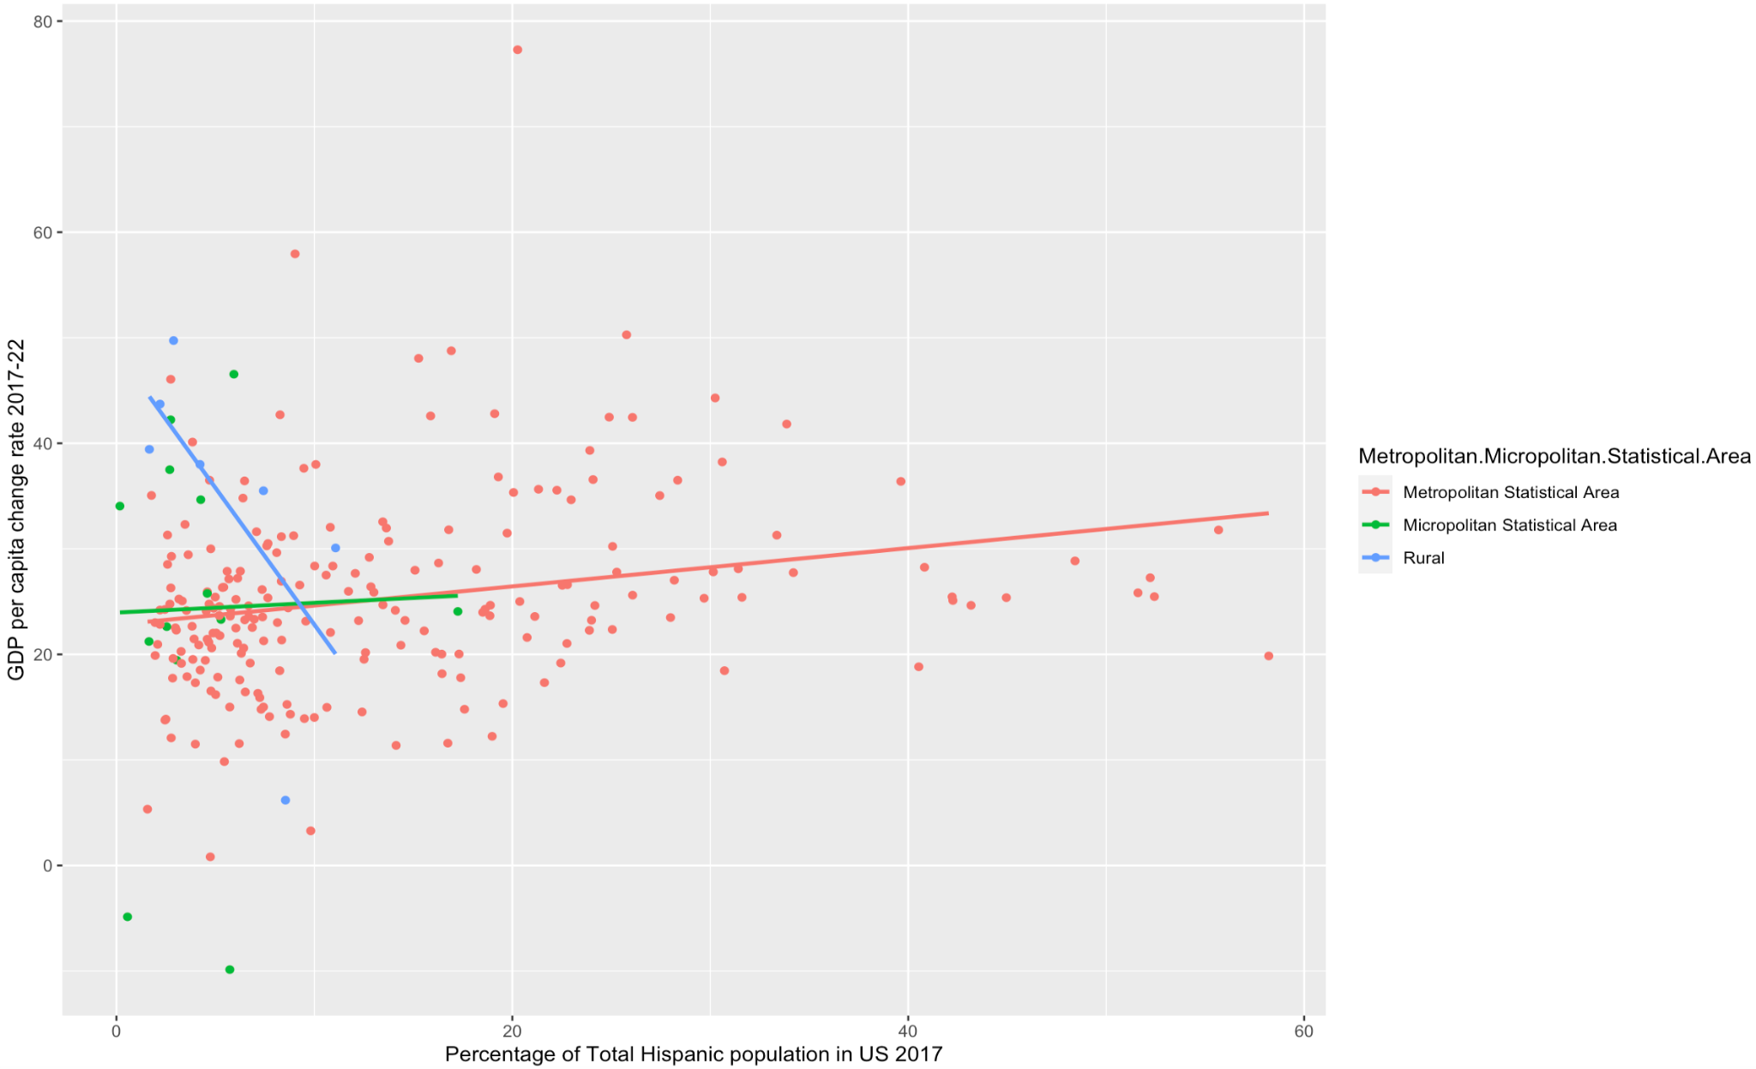

Slide 21
The graph shows that there is not much difference in the slope of Metropolitan Statiscal Area and Micropolitan Area for the percentage of Hispanic population in 2017 and GDP per capita change from 2017 to 2022 which is consistent with the linear model summary. The graph also shows that there is noticeable difference in the slope of Metropolitan Area and Rural Area for the percentage of Hispanic population in 2017 and GDP per capita change from 2017 to 2022 which is also consistent with the linear model summary.

Slide 22
Linear model of GDP per capita change rate 2017-2022 as function of percentage population of Total African American people in US 2017 and classification area
Call:
lm(formula = finaldata2$GDPpercapchangerate17_22 ~ finaldata2$percentotalblack17 *
finaldata2$Metropolitan.Micropolitan.Statistical.Area)
Coefficients:
Estimate
(Intercept) 24.92425
Percentage of Black population and Micropolitan Area combined effect -0.51559
Percentage of Black population and Rural Area combined effect 0.09057
Pr(>|t|)
(Intercept) <2e-16
Percentage of Black population and Micropolitan Area combined effect 0.0066
Percentage of Black population and Rural Area combined effect 0.6323
Multiple R-squared: 0.06024, Adjusted R-squared: 0.03963

Slide 23
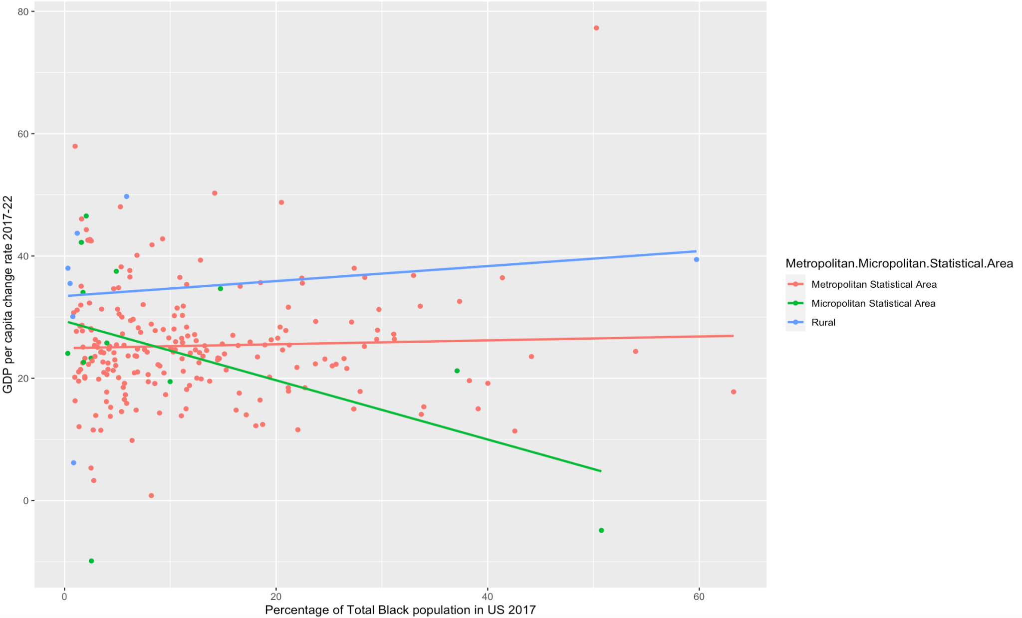

Slide 24
The graph shows there is not much difference in the slope of Metropolitan Statiscal Area and Rural Area for the percentage of Black population in 2017 and GDP per capita change from 2017 to 2022 is consistent with the linear model summary. The graph also shows there is noticeable difference in the slope of Metropolitan Area and Micropolitan Area for the percentage of Black population in 2017 and GDP per capita change from 2017 to 2022 which is also consistent with the linear model summary.

Slide 25
Anova Tests to test if difference in Average GDP per capita change rate 2017-2022 in different classifying areas significant

Slide 26
> summary(aov(dt$GDPpercapchangerate17_22 ~ dt$Metropolitan.Micropolitan.Statistical.Area))
Df Sum Sq Mean Sq F value Pr(>F)
dt$Metropolitan.Micropolitan.Statistical.Area 2 79021 39511 40.46 <2e-16 ***
Residuals 3046 2974475 977
---
Signif. codes: 0 ‘***’ 0.001 ‘**’ 0.01 ‘*’ 0.05 ‘.’ 0.1 ‘ ’ 1
92 observations deleted due to missingness

Slide 27
Correlations
GDP per capita change rate from 2017 to 2022 and Percentage of Indian population in 2017 : 0.02738132
GDP per capita change rate from 2017 to 2022 and Percentage of Hispanic population in 2017 : 0.1811168
GDP per capita change rate from 2017 to 2022 and Percentage of African American population in 2017 : -0.01343505

Slide 28
Conclusions
Out of the three races , Hispanic population has the most positive impact on GDP per capita change rate 2017-2022
The difference in Average GDP per capita change rate 2017-2022 in different classifying areas is significant

Slide 29
Citations:
Bureau of Economic Analysis. "BEA Regional Data." U.S. Department of Commerce,
https://apps.bea.gov/regional/downloadzip.cfm?_gl=1*dwaf9w*_ga*NjYzMzgwMDA0LjE3MDI0MzU3NzU.*_ga_J4698JNNFT*MTcwMjQ0MjYzOC4yLjEuMTcwMjQ0NTQ4OS4wLjAuMA
Equitable Growth. "Gaps in U.S. Rural and Urban Economic Growth Widened in the Post-Great Recession Economy, With Implications Amid the Coronavirus Recession." Washington Center for Equitable Growth,
Gaps in U.S. rural and urban economic growth widened in the post-Great Recession economy, with implications amid the coronavirus recession.
U.S. Census Bureau. "Asian Population and Partners." https://www.census.gov/about/partners/cic/resources/data-links/asian.html.
https://headwaterseconomics.org/economic-development/trends-performance/hispanic-populations/
https://en.wikipedia.org/wiki/Black_Southerners#:~:text=Since%20the%20second%20Great%20Migration,Virginia%2C%20Tennessee%2C%20and%20Florida.
https://www.hhs.gov/guidance/document/defining-rural-population#:~:text=All%20counties%20that%20are%20not,as%20either%20Metro%20or%20Micro.

